Slide 1
Update: Integration of single cell transcriptomic atlases of the adult human and mouse ventral midbrain

Slide 2
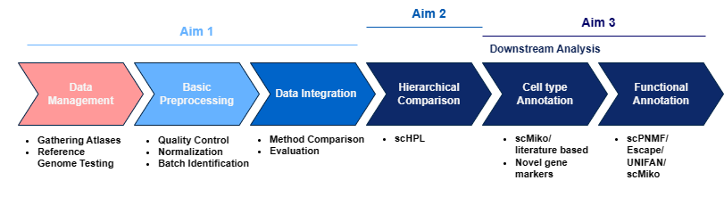
Recap: Aim
Integrate multiple atlases into one unified (ventral) midbrain atlas for mouse and one for human
Determine relations between identified cell types by the authors of the atlases
Determine (new) cell types, functions and potential marker genes in an unbiased manner

Slide 3
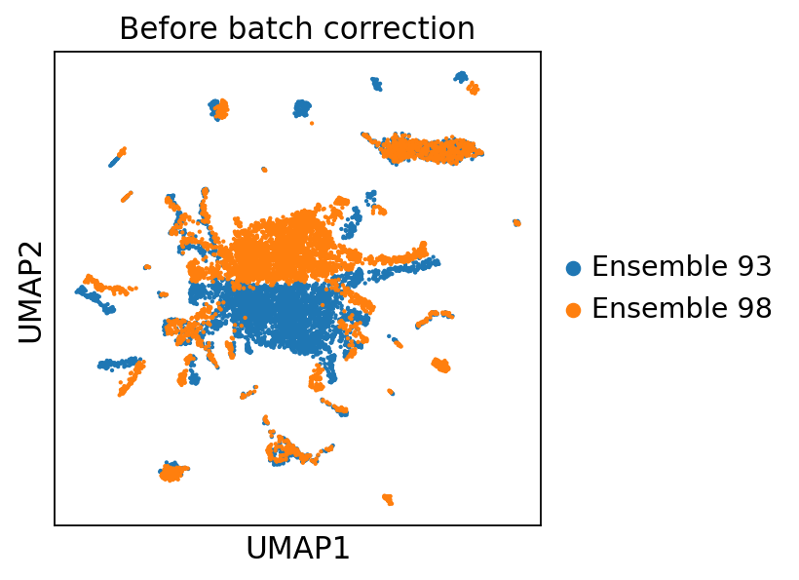
Last time: Zhong et. al. comparison
Cell Ranger v3 + Ensemble 93
vs
Cell Ranger v6.1 + Ensemble 98

Slide 4
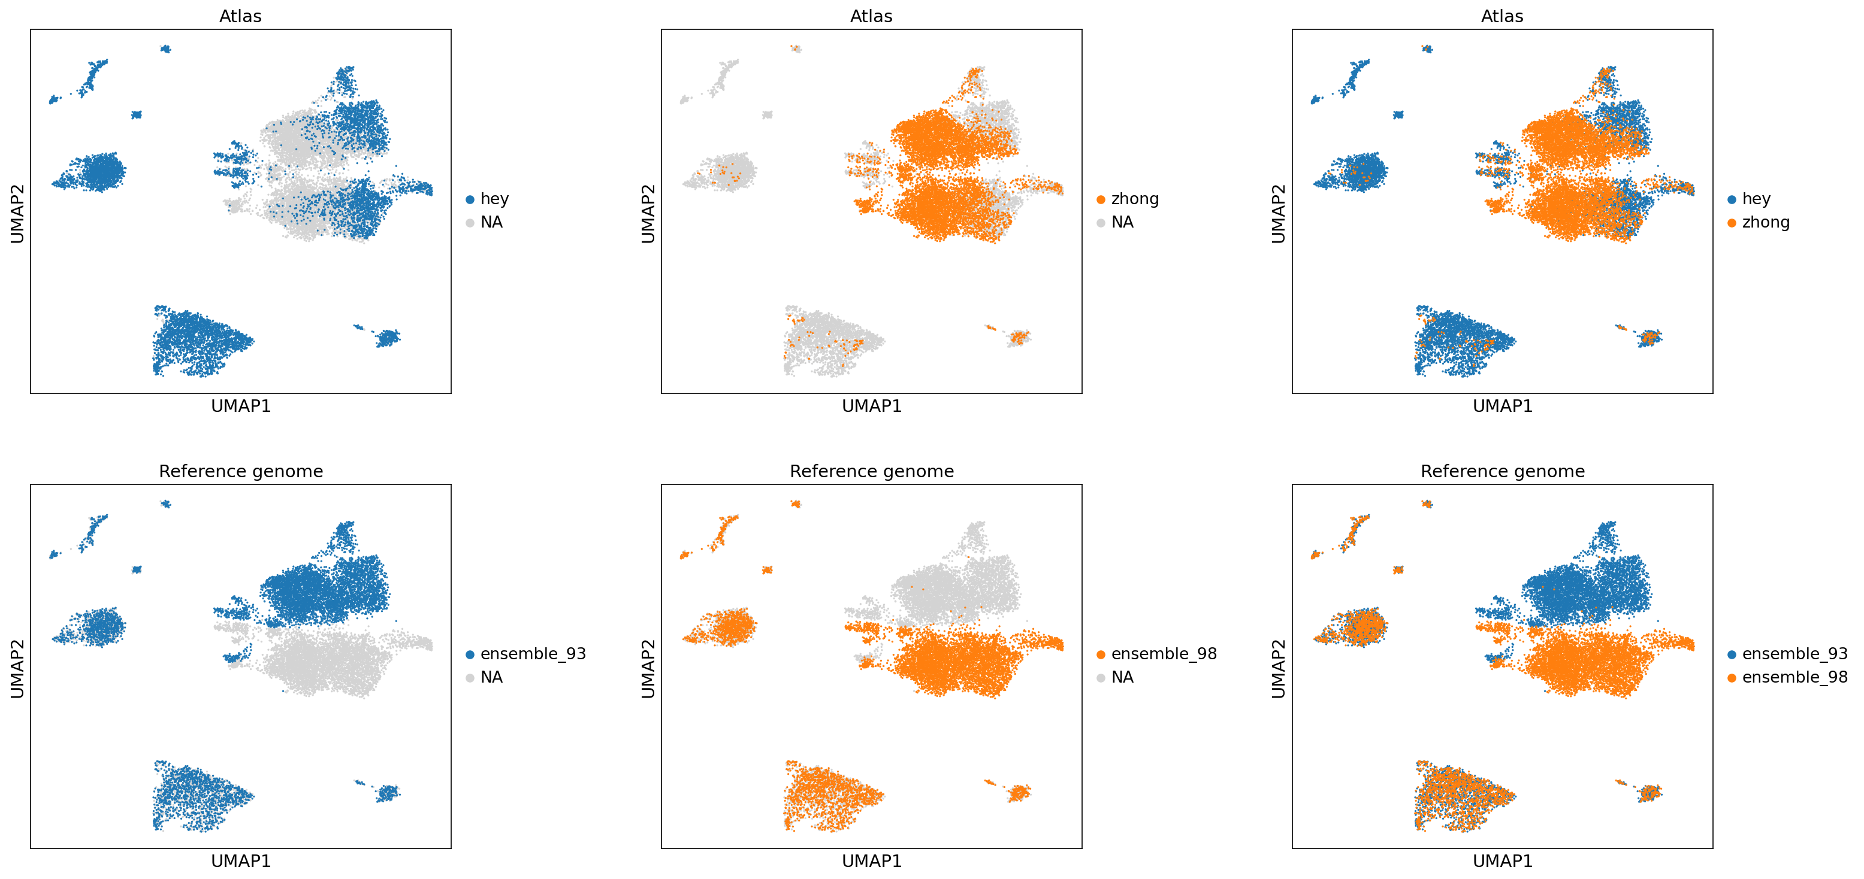
More tests: Reference Genome 93 vs 98

Slide 5
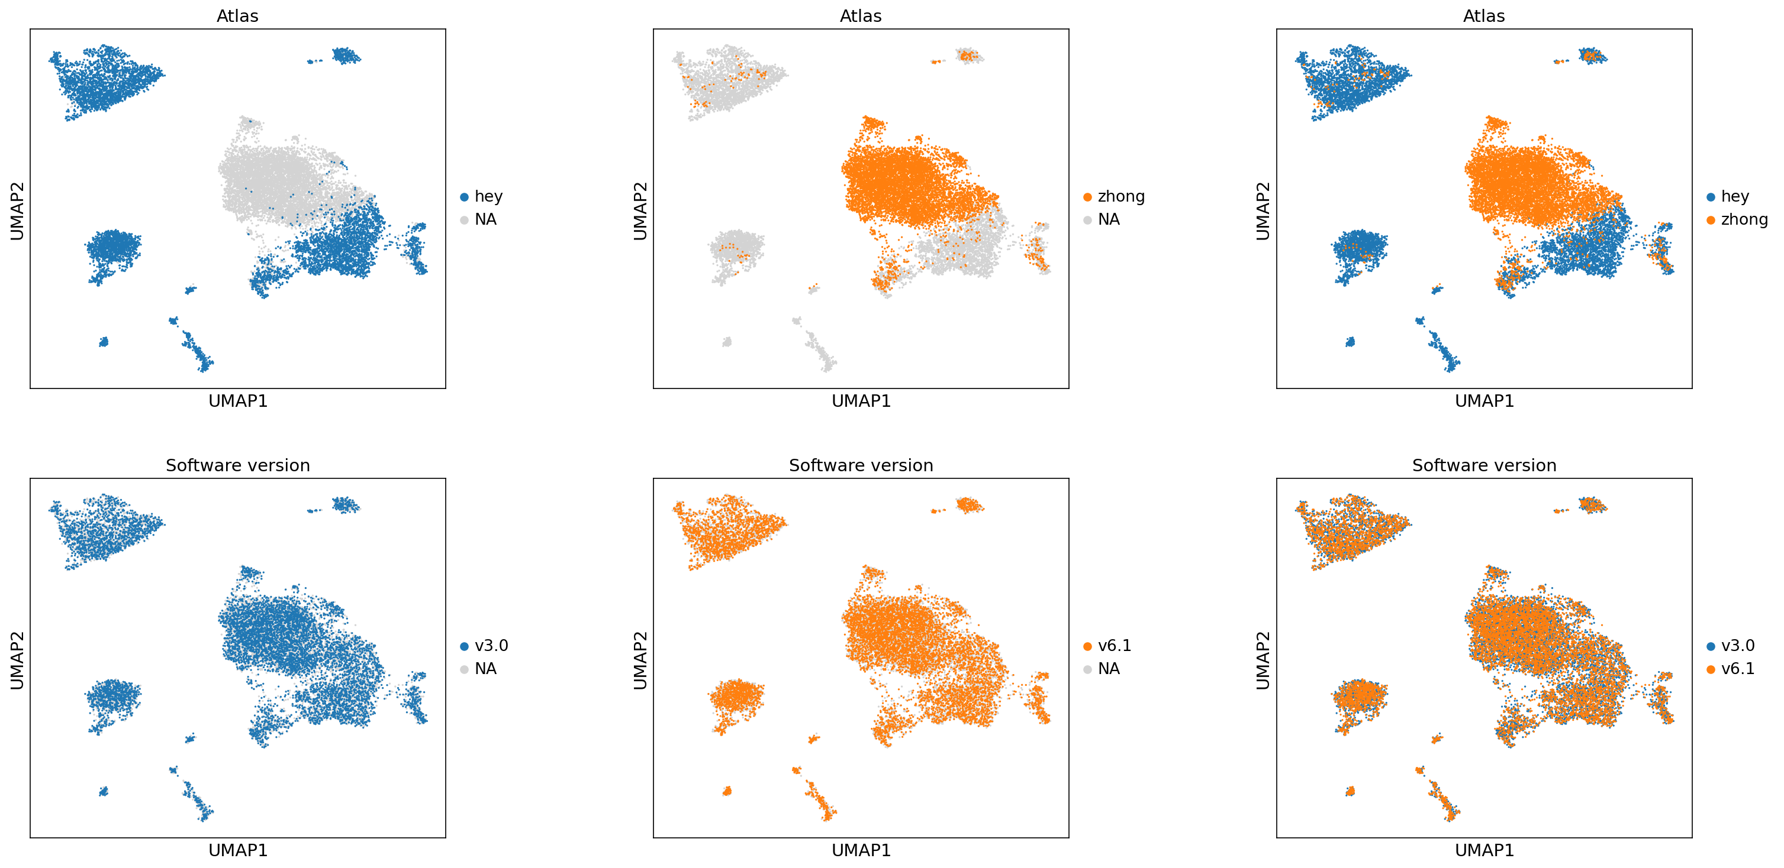
More tests: Software Version v3 vs v6.1

Slide 6
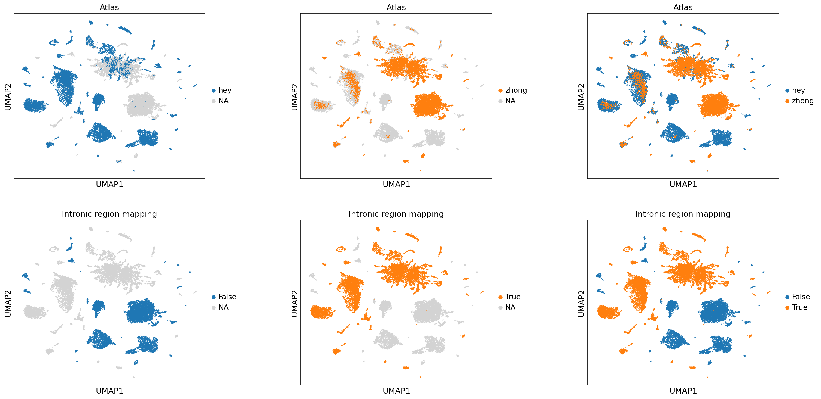
More tests: Intronic Mapping

Slide 7
Waiting for mouse data
scRNA atlas | Status
Yao et. al. (2023) | July 2023 (750,851 brain cells)
Zeisel et. al. (2018) | Old chemistry 10x_v1 (74,000 brain cell)
Saunders et. al. (2018) | Ready (44,091 brain cells)
Hook et. al. (2018) | Ready (473 DA cells)
La Manno et. al. (2016) | Ready (245 adult midbrain cells)
snRNA atlas | Status
Langlieb et. al. (2023) | Unknown (4,388,420 brain nuclei total)
Zhong et. al. (2021) | Ready (5202 nuclei)
Hey et. al. () | Ready

Slide 8
Human data
snRNA atlas | Status
Kamath et. al. (2022) | Requested (15,684 DA nuclei)
Siletti et. al. (2022) | Ready (296,714 midbrain nuclei)
Wang et. al. (2022) | Ready (152,899 healthy SN nuclei)
Agarwal et. al. (2021) | Ready (10,830 SN nuclei)
Smajic et. al. (2021) | Ready (30,301 SN nuclei)
Welch et. al. (2019) | Ready (44,274 SN nuclei)
Van Regteren Altena et. al () | Ready (89,976 VTA nuclei)
Total | 624,994 nuclei (unfiltered)

Slide 9
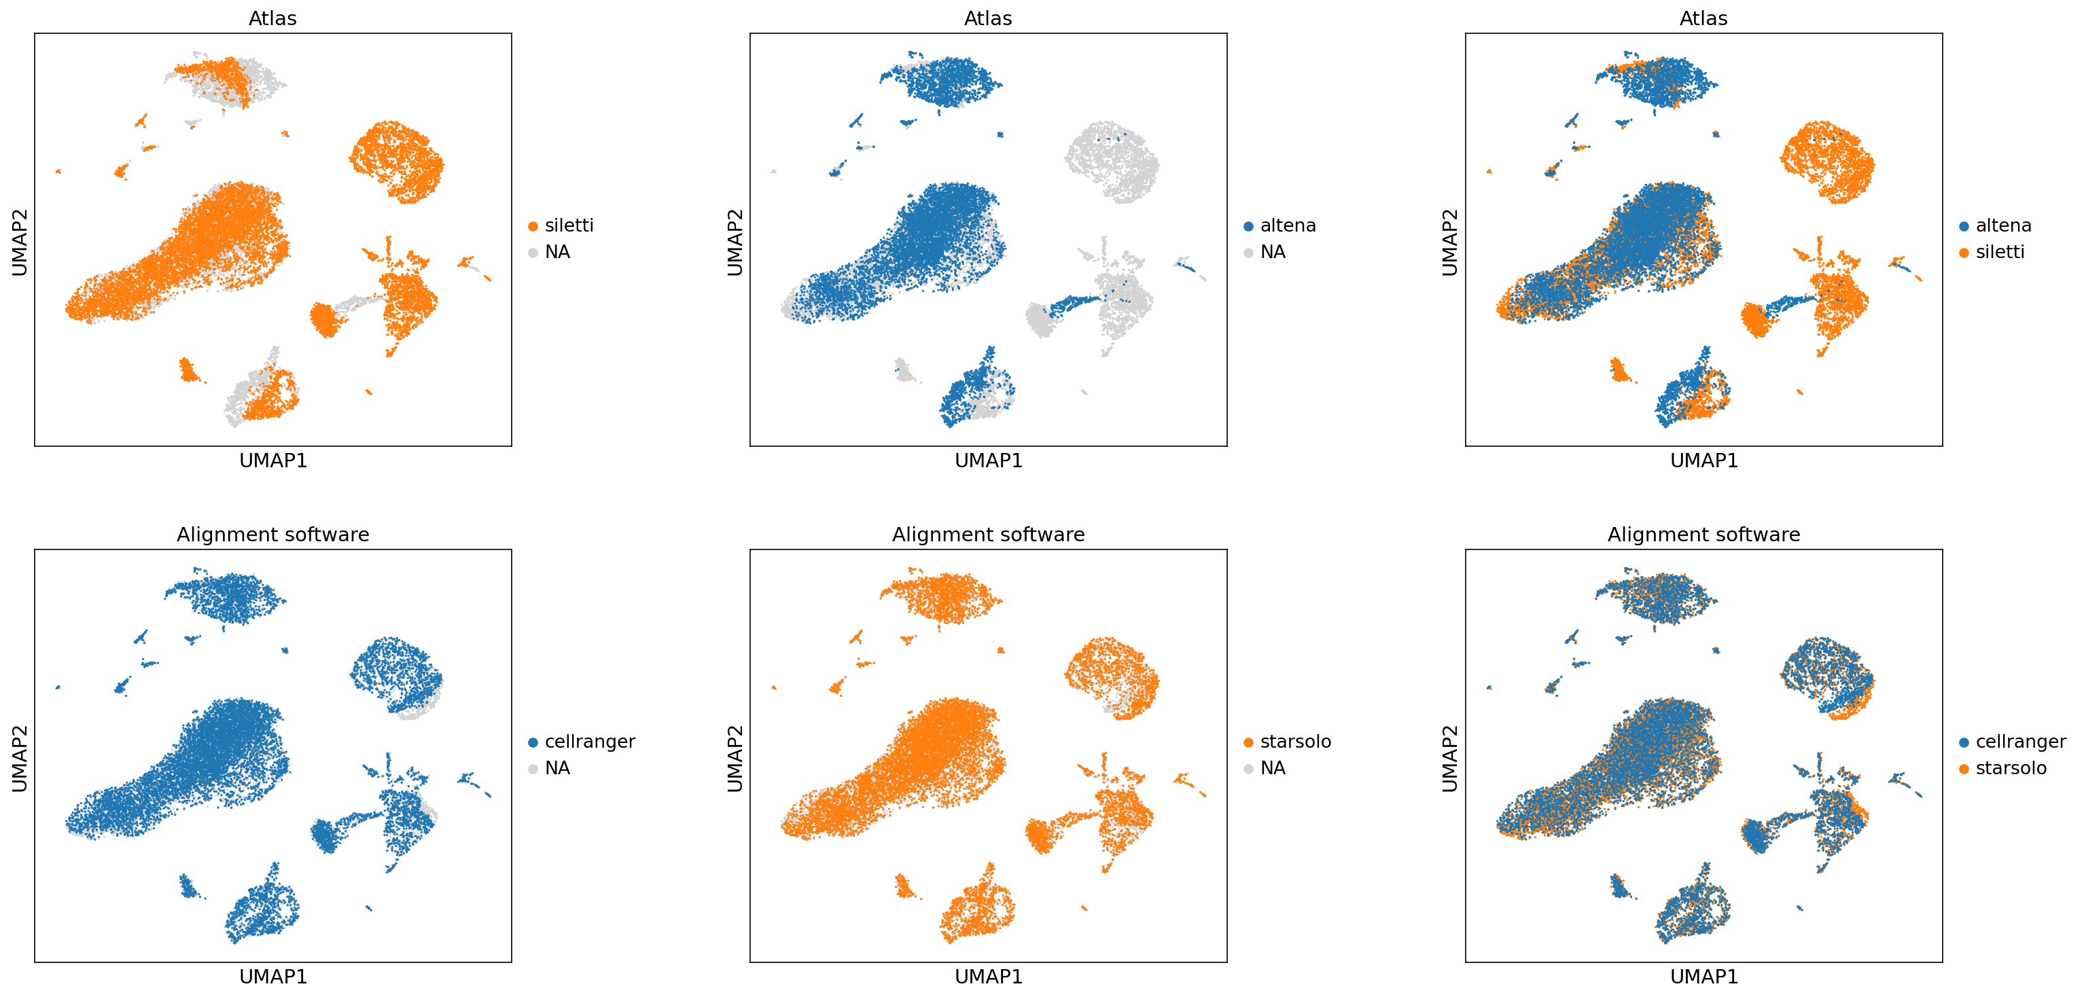
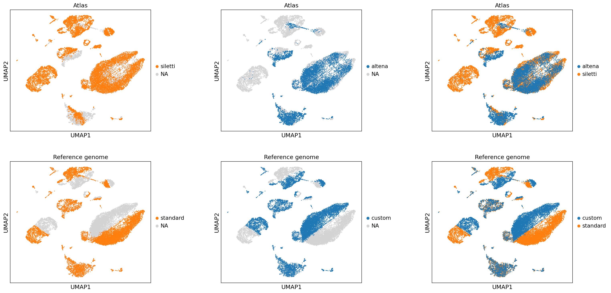
More tests: Siletti et. al.
Starsolo instead of Cell Ranger for alignment
Custom reference genome based on Ensemble 109

Slide 10
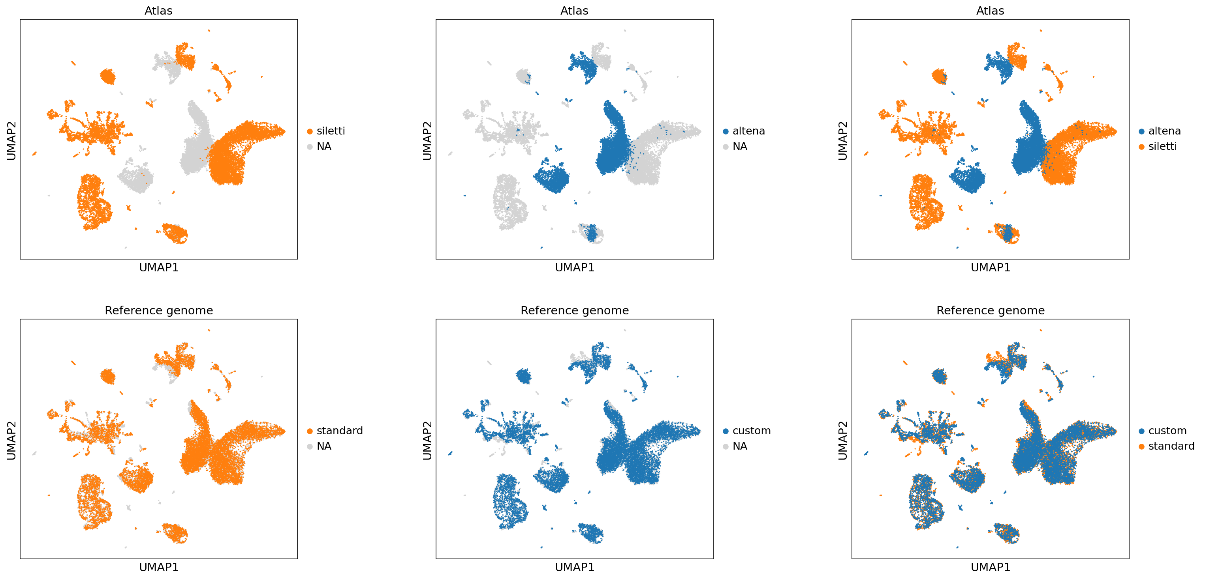
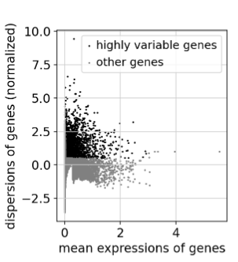
More tests: Siletti et. al. with only highly-variable genes

Slide 11
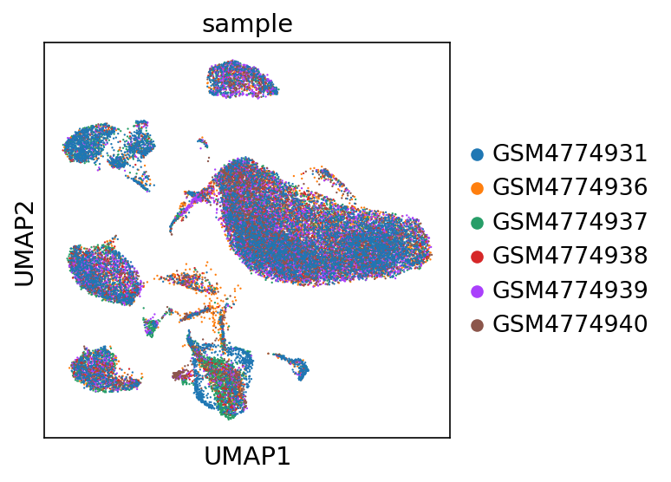
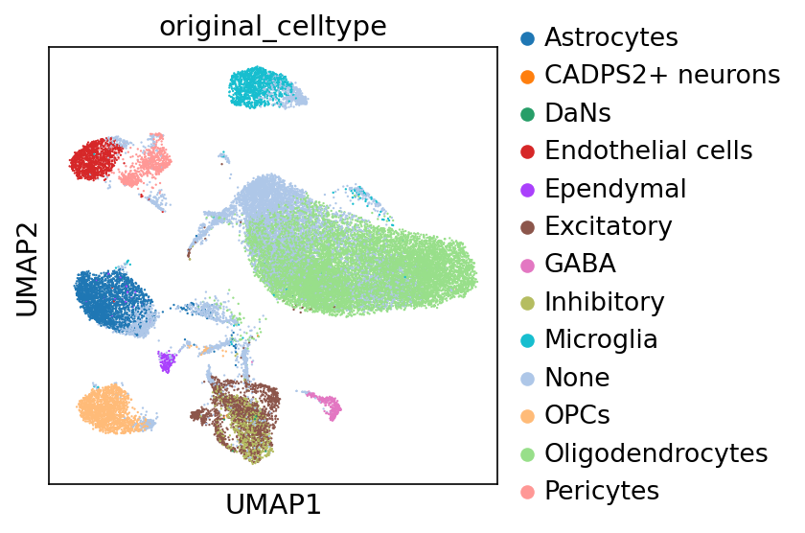
Smajic atlas

Slide 12
Acknowledgements
Basak Lab
Onur Basak
Tiziana Hey
Abdool Al-Khaledi
Cecile Herbermann
Hol Lab
Anna van Regteren Altena
Others
Kimberly Siletti

Slide 13
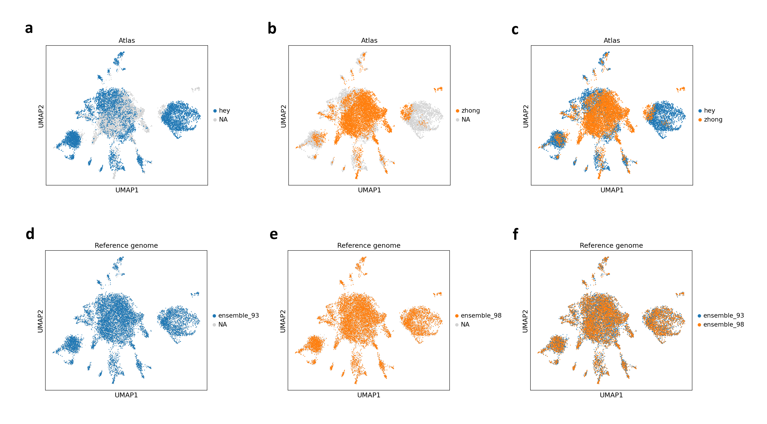
More tests: reference genome regress and highly-variable genes

Slide 14
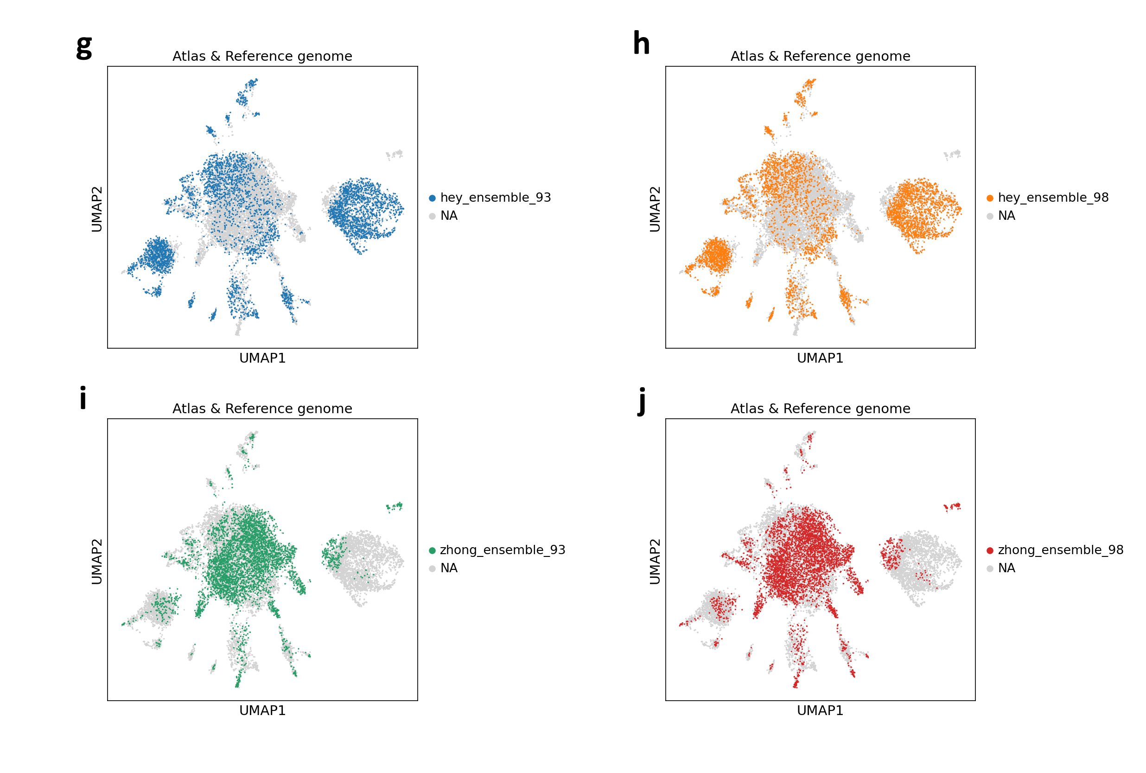
More tests: reference genome regress and highly-variable genes

Slide 15
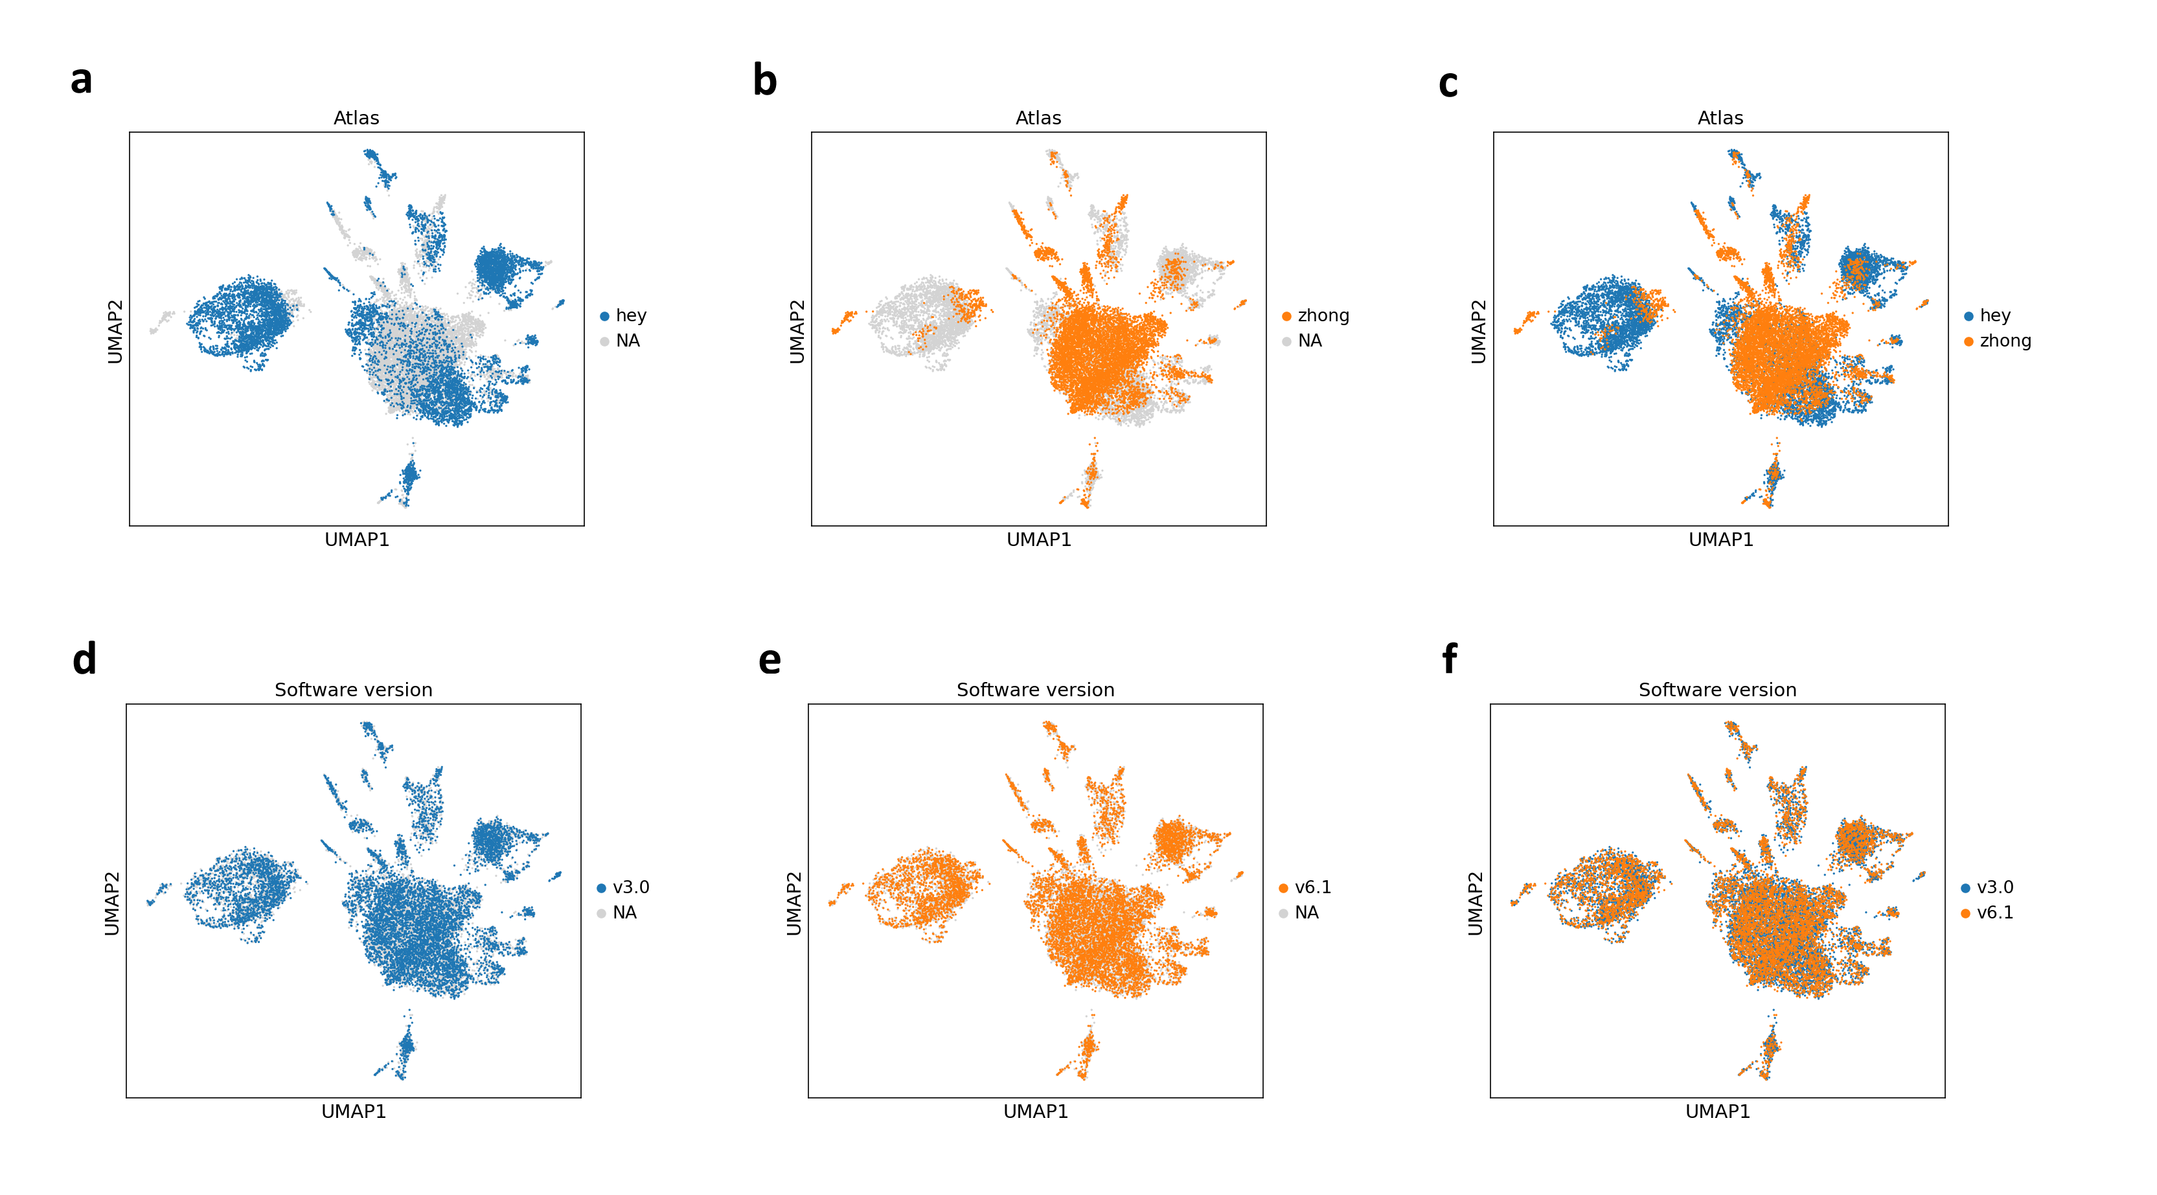
More tests: software version regress and highly-variable genes

Slide 16
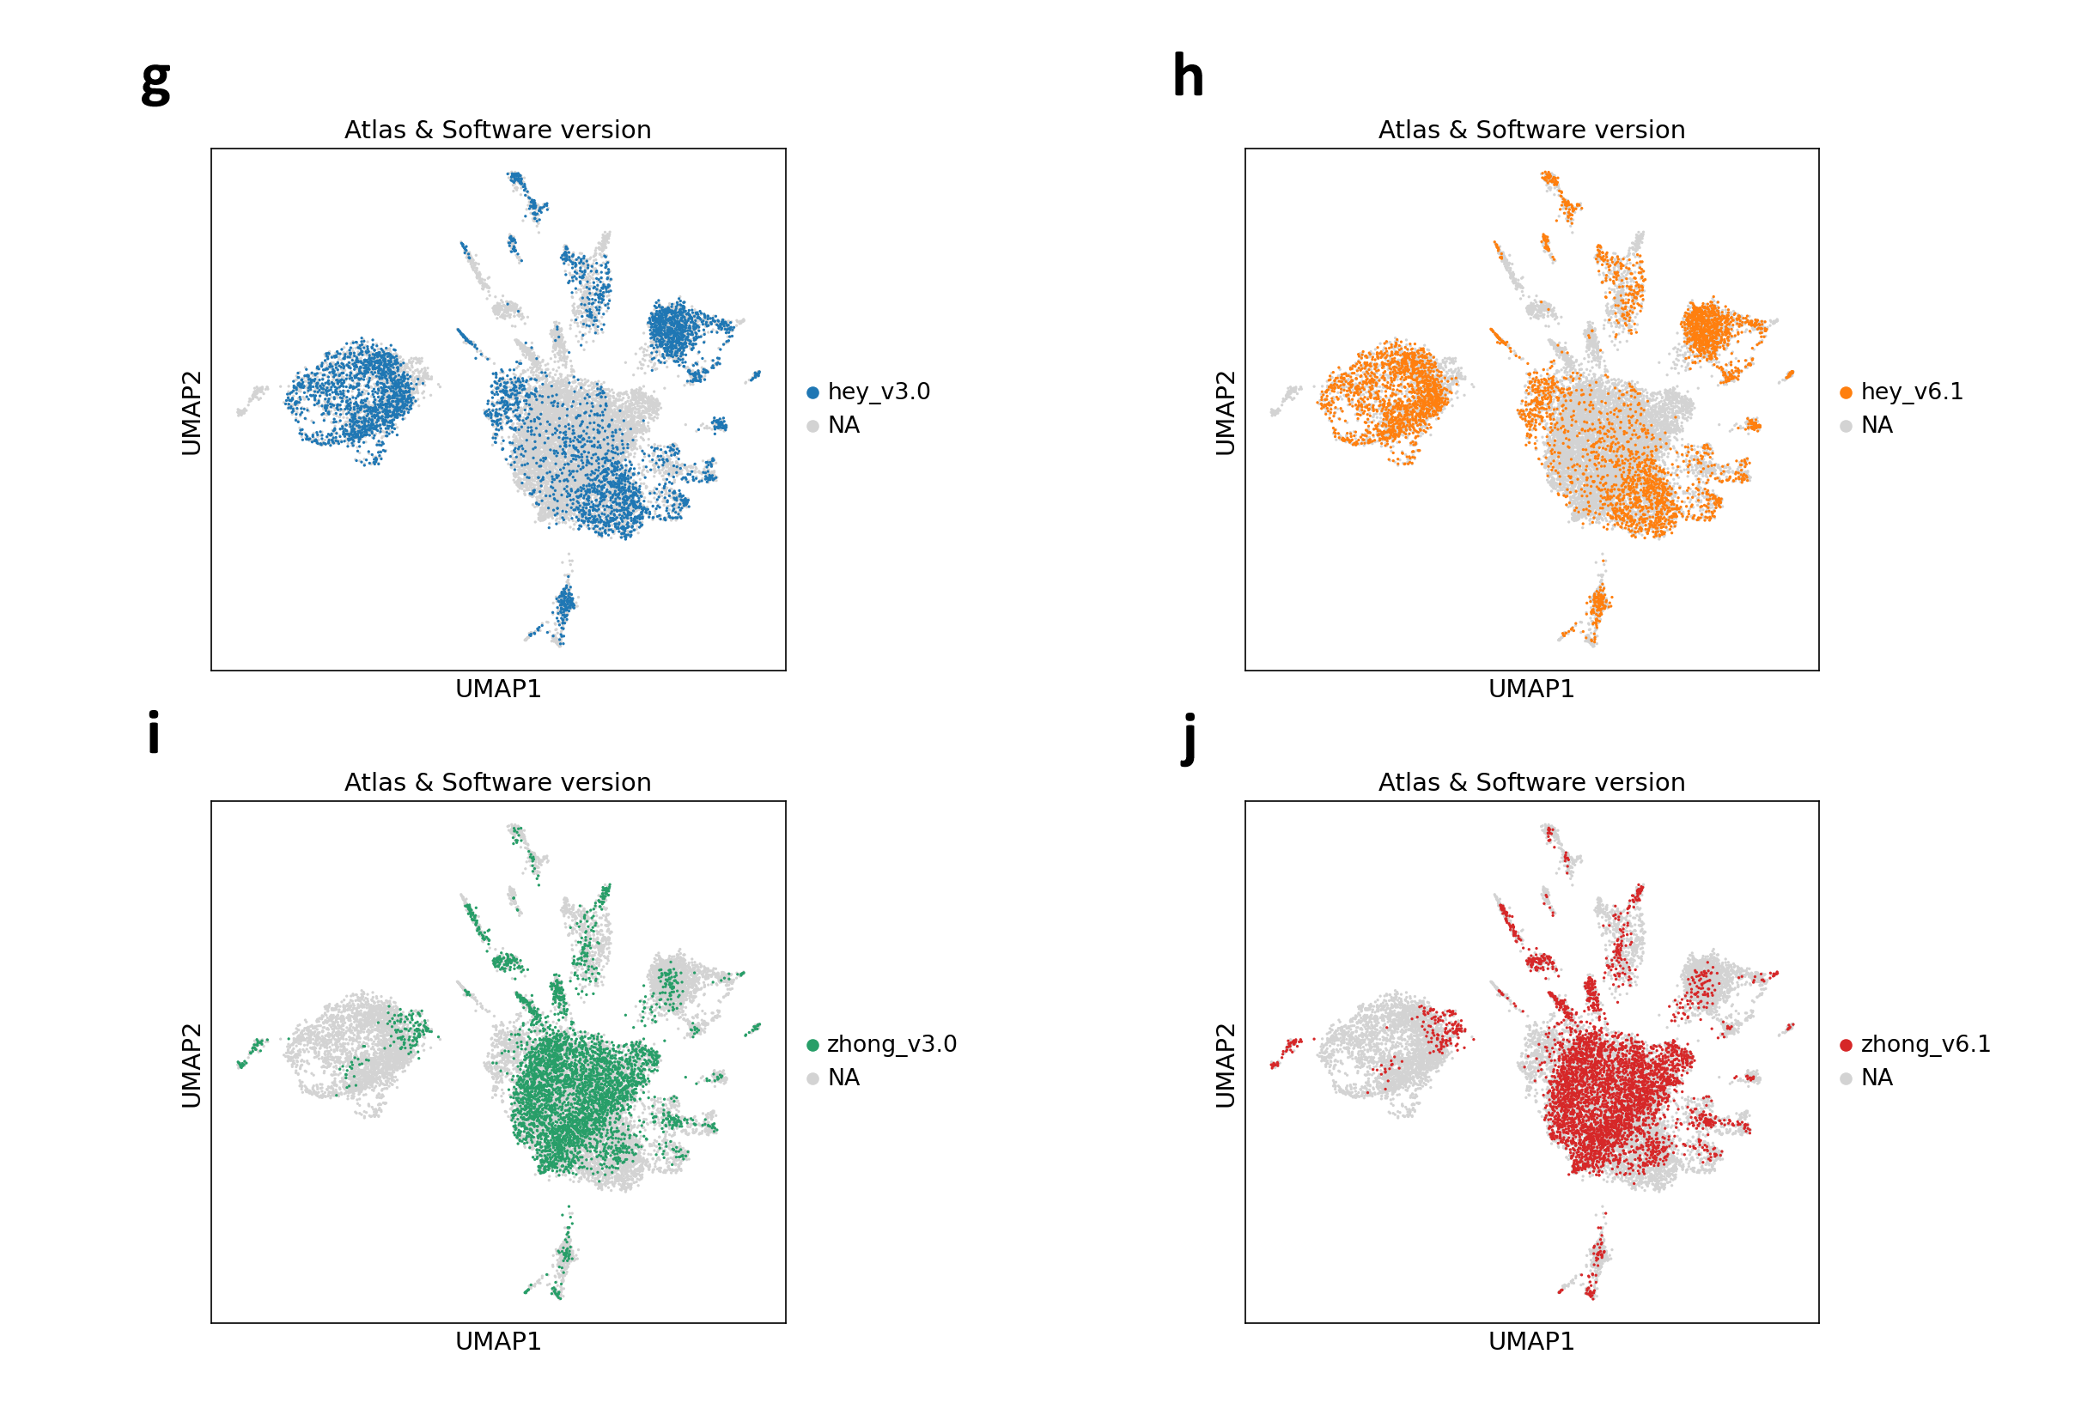
More tests: software version regress and highly-variable genes

Slide 17
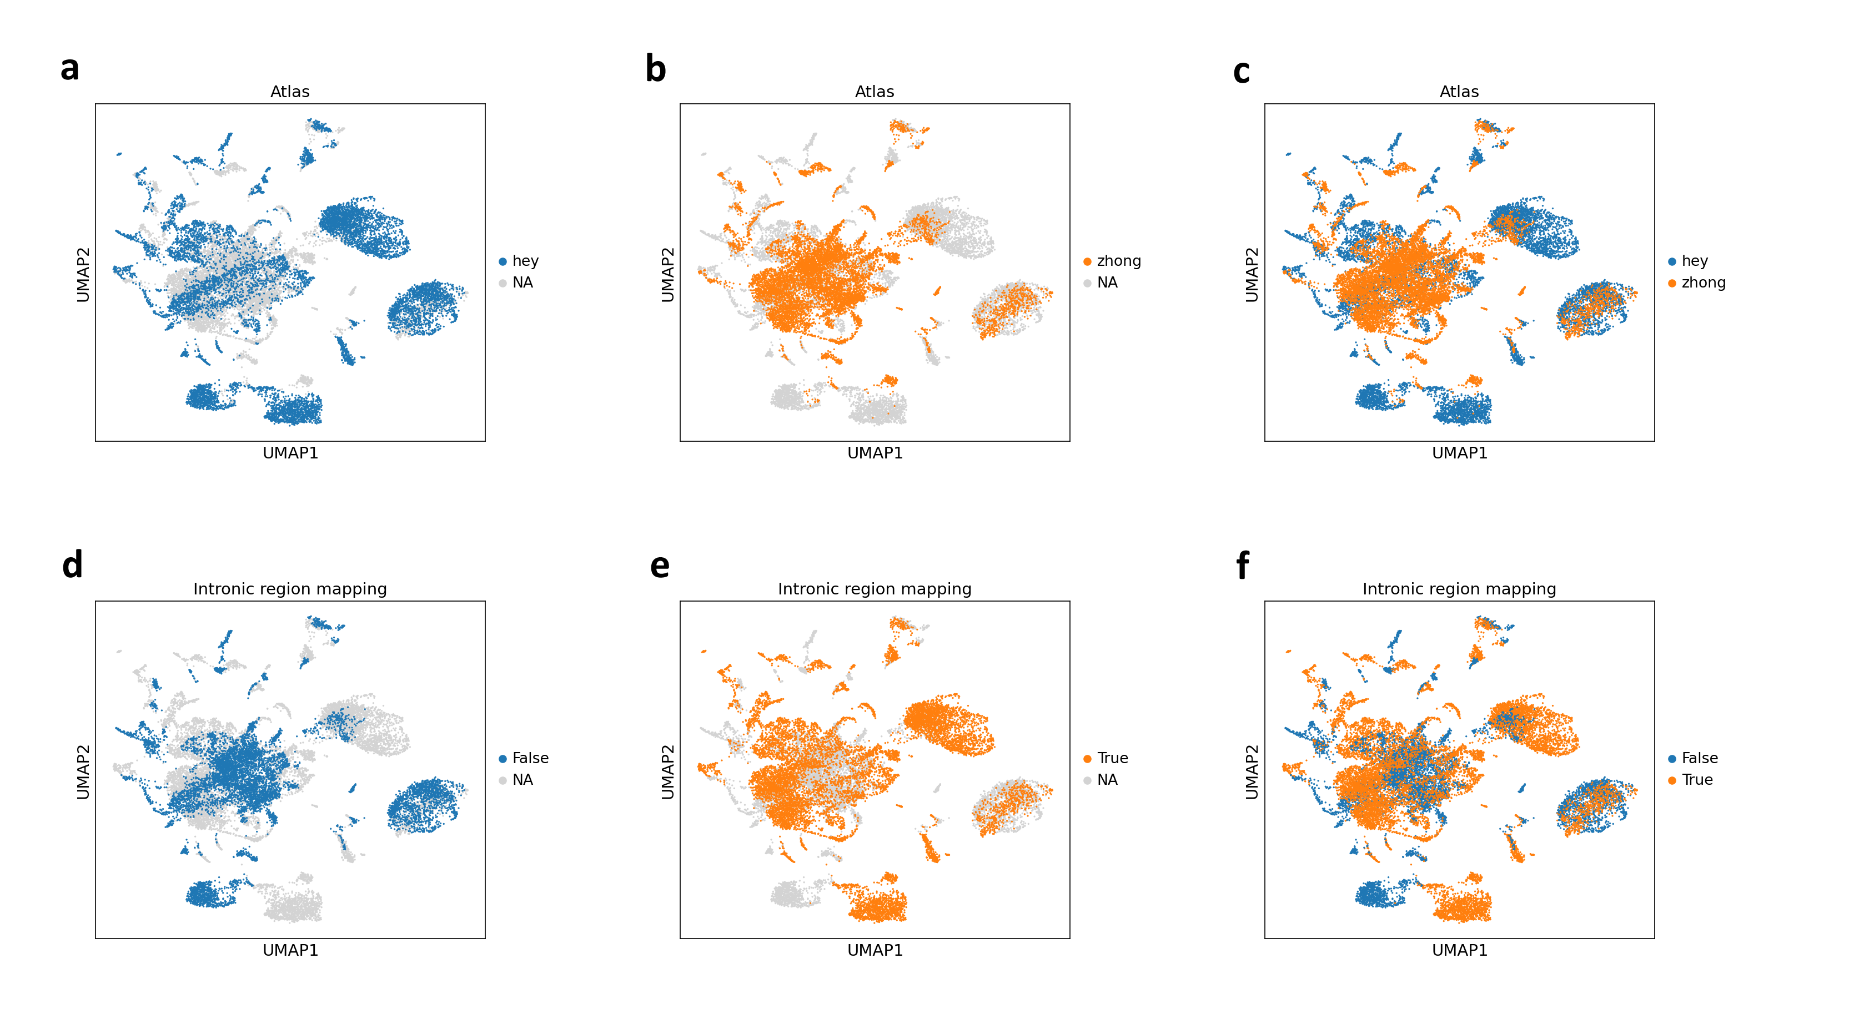
More tests: intronic mapping regress and highly-variable genes

Slide 18
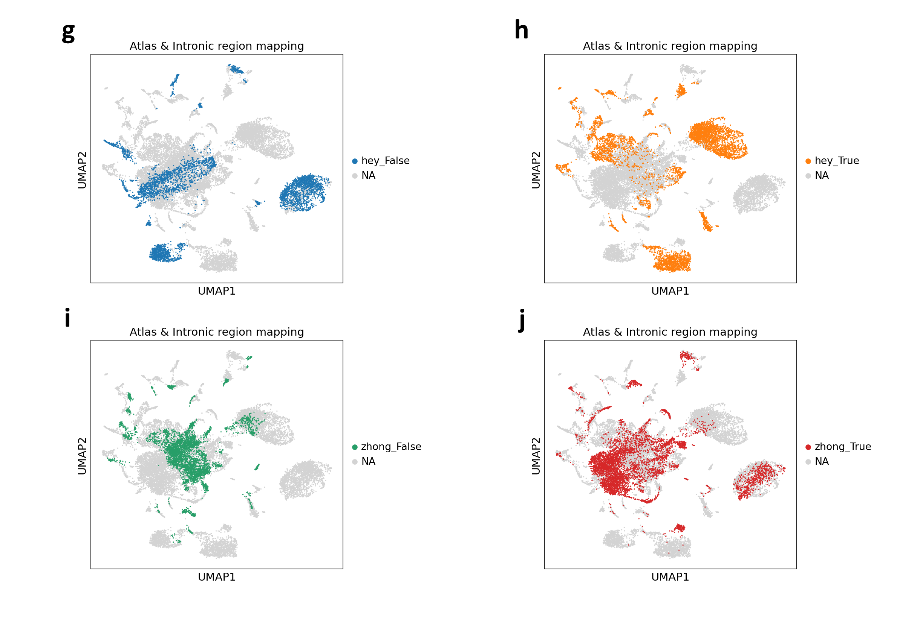
More tests: intronic mapping regress and highly-variable genes

Slide 19
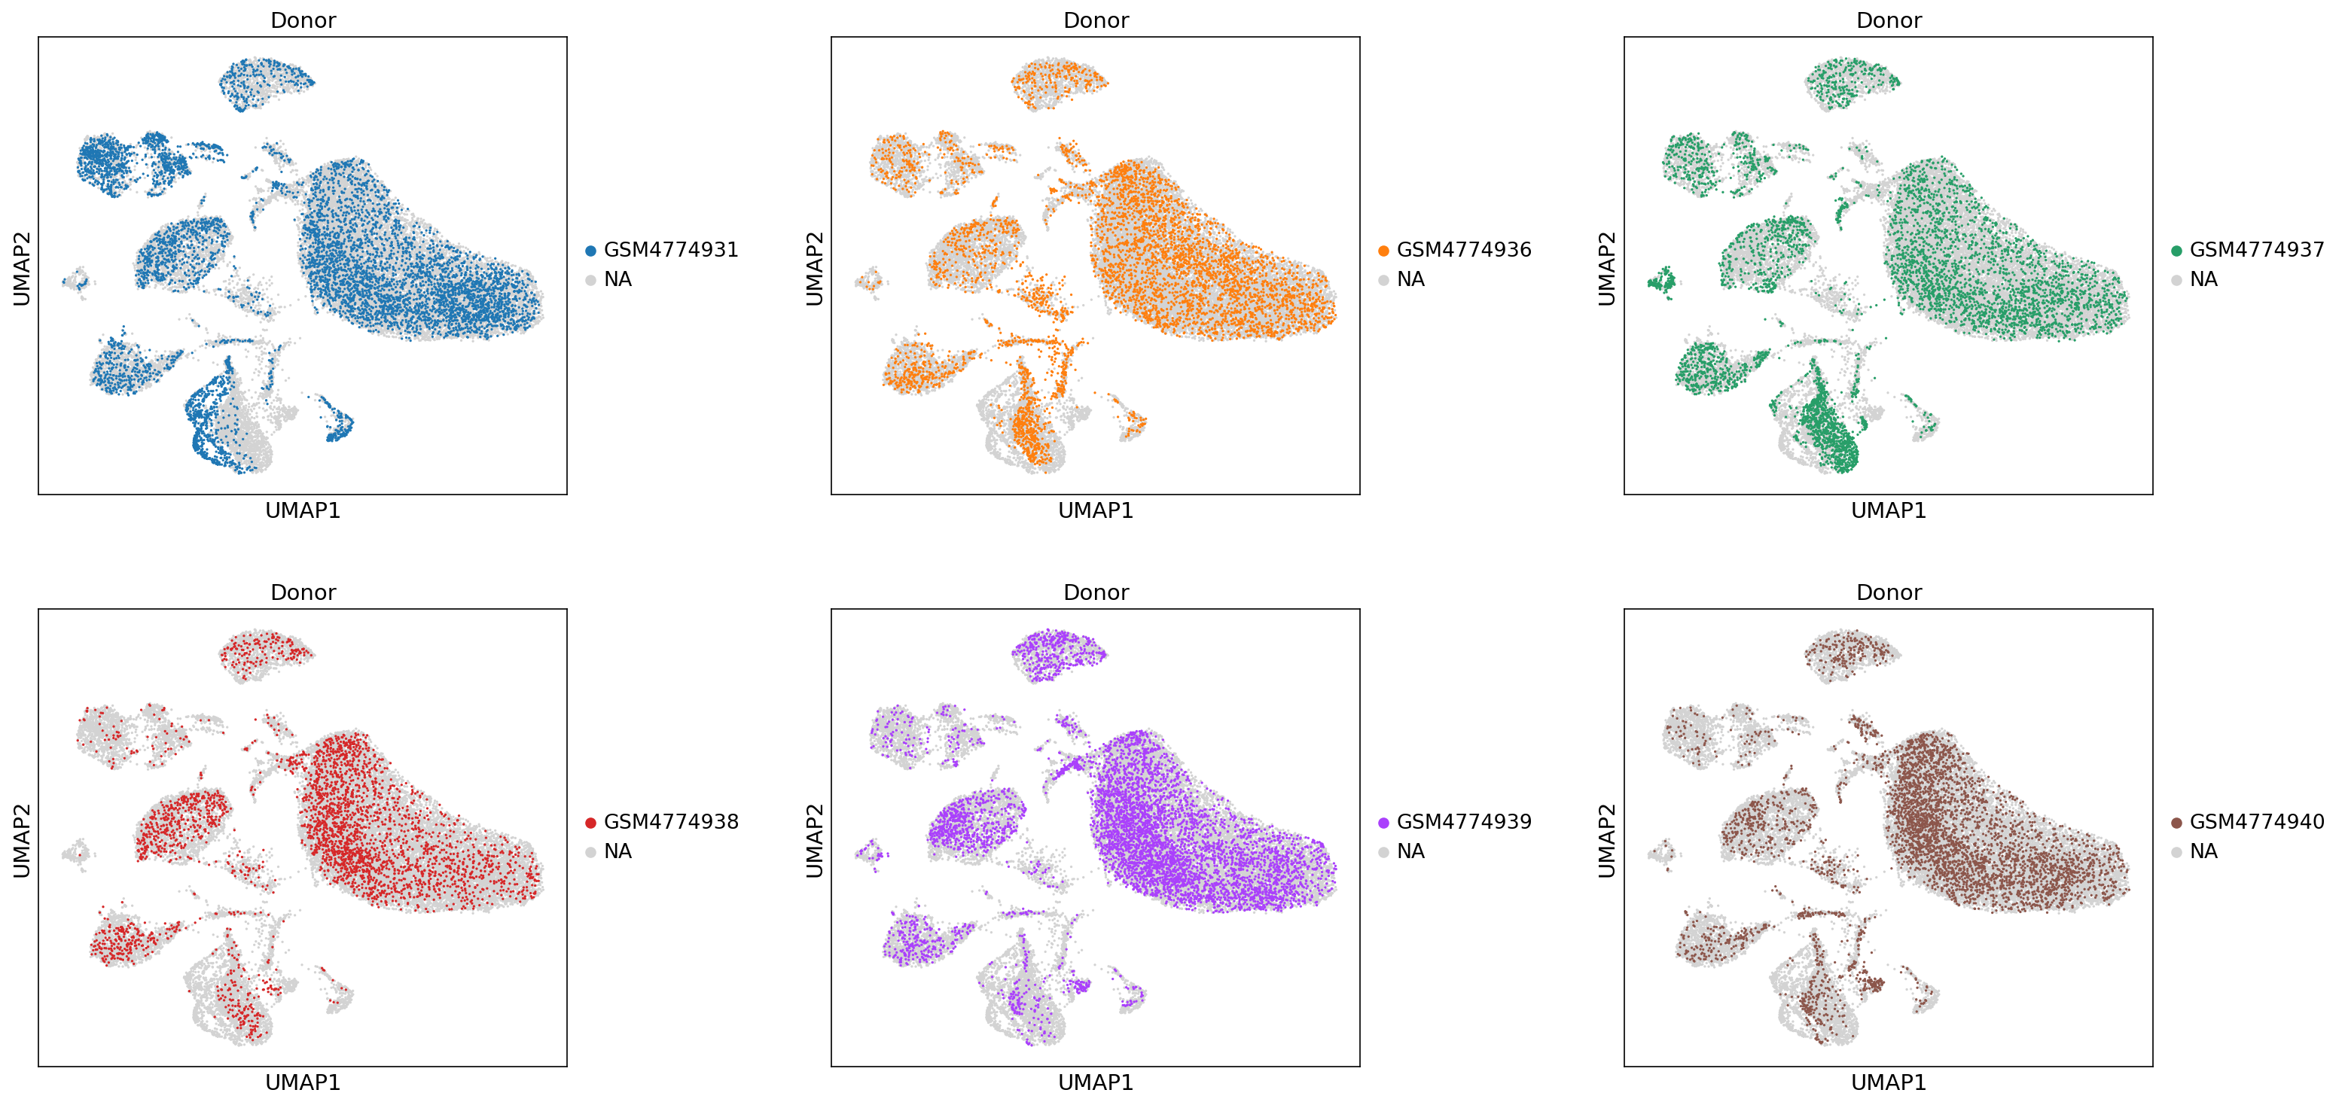
Smajic samples

Slide 20
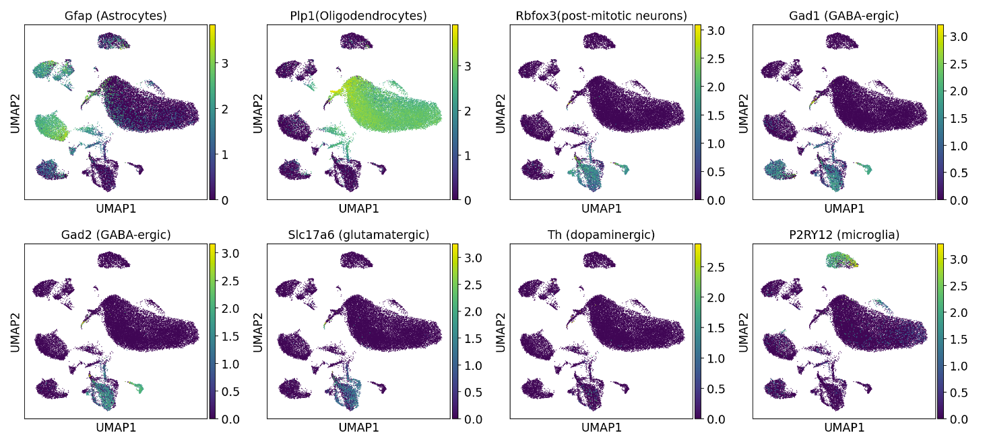
Smajic markers

